Slide 2


C & U Emergency Safety Trainings
(California & Uganda)
Africa – Uganda Division
Presents
www.UgandaHealthNews.com

Slide 3
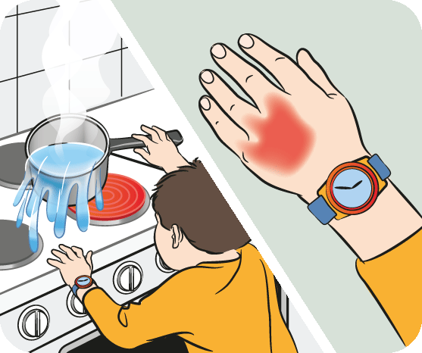
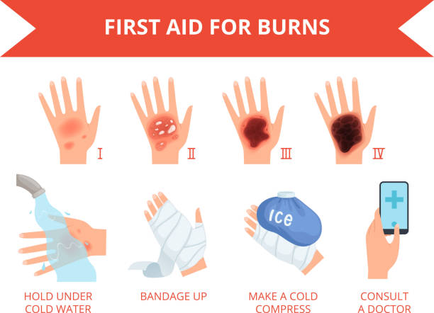
Burn Safety
How To Teach Burn Safety
Lesson Plan

Slide 4


BURNS & SCALDS
Lesson Plan
Sample #1 – Draft For Discussion
This Is Our First Presentation In Uganda
www.UgandaHealthNews.com

Slide 5

This Material is designed to:
Educate Educators so they can then educate students
Be taught in one class period
Provide additional online support
Ensure that students will receive one hour of education per day
for one full week, per subject
www.UgandaHealthNews.com

Slide 6

Materials
Additional Material Being Created:
Subject based narratives (To help you teach more effectively)
Video and slide shows to support the creative narrative
Handouts – will depend on the material - one or multiple
All material will be produced in English, Luganda and Swahili
www.UgandaHealthNews.com

Slide 7

Educator Goal(s):
Educators will be able to do the following by the end of their training:
Have enough training to effectively create and follow lesson plans for use in their respective classroom(s)
Be able to extrapolate information for the appropriate grade level - K-12
Suggest ideas and report “structural bugs” that they may encounter so they can be addressed, but share their lesson plans by placing them in an online archive for future use
Use our website’s soon-to-be Educator Interface to find selected information, share ideas and receive support

Slide 8

Student Goal(s):
Students will be able to do the following by the end of this lesson:
  - Recognize a burn and/or a scald
  - Treat the burn
  - Be able to determine which burns need advanced medical treatment and which don’t
  - Help protect the burn until medical treatment is available (if needed)
www.UgandaHealthNews.com

Slide 9

Suggested
We suggest that every day, for one week, each class conduct about an hours worth of training/education/instruction. This will be based on the educator’s needs, understanding and number of students. As such, this is a suggested amount of time, and obviously based on classroom dynamics, the amount of time spent will fluctuate. Each session should include a short, 20 minute lecture, and one class activity that will last about 20 minutes. The last 20 minutes should be a question and answer/wrap up session. Even if educators can’t spend one full hour on a lesson, over the week, the presentation time will balance out to between 4 and 5 instruction hours. The suggested daily schedule for this subject is:
Monday: Introduction to burns;
Tuesday: Identifying types of burns and how to treat them;
Wednesday: Identifying types of burns and how to treat them;
Thursday: Review and Hands on demonstration(s);
Friday: A Test.
www.UgandaHealthNews.com

Slide 10

The following options should be considered/used to compliment the day’s 20 minute discussion/lecture
www.UgandaHealthNews.com

Slide 11
Activity #1: Monday
Watch burns and scalds video clip and/or PowerPoint Presentation (The information in this presentation)
Introduce the following types of burns: 1st Degree, 2nd Degree, 3rd Degree, electrical, chemical and radiation
www.UgandaHealthNews.com

Slide 12
Activity #2: Monday
Activity length: Suggested time: 20 minutes
Divide the class into groups of equal numbers and ask them to write: (10 minutes)
  The types of ways someone can burn themselves;
  Write one example of each type of burn;
Then, as a class, write the responses on the black or white board and discuss them; (10 minutes)
Needs: Whiteboards or Paper and pens for each group;
After discussing the class’s responses, have them break back into their groups and discuss the presented burns. If possible, have the students categorize them by discussing what caused each injury, how they can prevent it and how to treat it. (10 minutes)
www.UgandaHealthNews.com

Slide 13
Activity #3: Tuesday
Discuss the six types of burns: dry, scald, electrical, cold, chemical and radiation – using pictures/video/slides;
www.UgandaHealthNews.com

Slide 14
Activity #4: Wednesday
Create a card game. Have each student create one card relative to a type of burn. On the card, they should define the type of burn, how it probably happened, and what they would do to take care of it. Have the students discuss the answers in pairs. 20 minutes

Slide 15
Activity #5: Thursday – Review – & hands on
PowerPoint presentation #2 - Ensure that they have grasped the main aim of treating a burn – to cool it – and that they are aware that the minimum time a burn should be cooled is 10 minutes (20 minutes for chemical burns). 10 minutes
Hands on training – learning how to treat the various burns – practice identifying, treating and bandaging the burn
www.UgandaHealthNews.com

Slide 16
Activity #6: Friday test
Create a ‘test’ to see how well the students have learned the information
You can use a power point presentation to test students on the types of burns. Using the presentation’s slides, ask the students to write a short essay – what type of burn and how to treat it (Students in younger grades should be able to write 2 or 3 sentences, while older students should be able to write fully structured essays).
Give them 7 – 10 minutes to answer each question. Test should have at least one question on each type of burn and consist of no more than 10 questions.
www.UgandaHealthNews.com

Slide 17
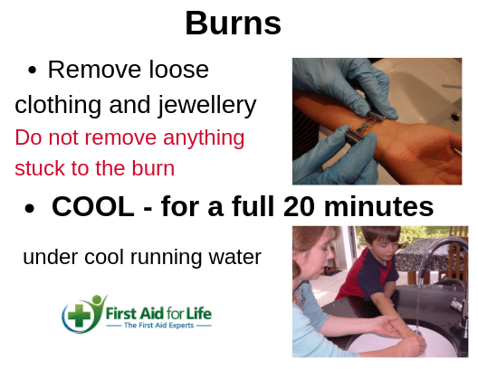
First Aid for Burns
Learning Objective: Determine first aid treatment for burns
Characterize degrees of burns;
Describe how to treat first, second, and third-degree heat burns;
Describe how to treat electrical burns;
Describe how to treat chemical burns to the eyes and skin.
www.UgandaHealthNews.com

Slide 18

WHY IS THIS IMPORTANT?
Learning about how to prevent and treat burns is important for a variety of reasons. The largest is this: by learning this material, you will be doing you’re share as a good citizen to help enhance the health of your family, fellow students, school, community and country.
www.UgandaHealthNews.com

Slide 19
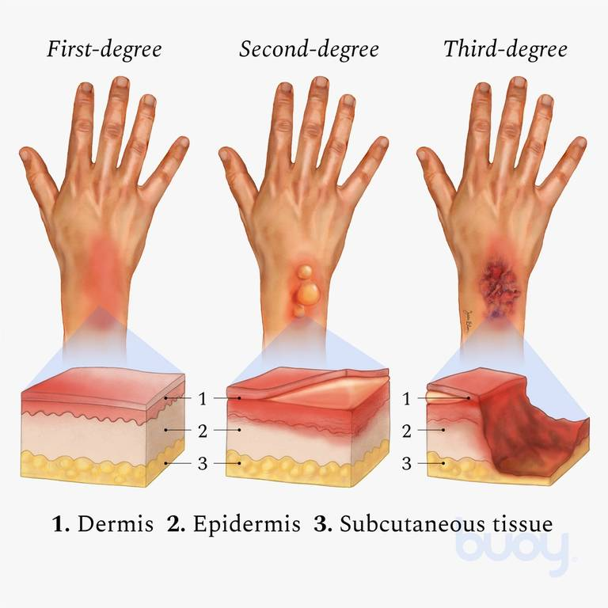
What you will accomplish in this lesson:
Learn to:
  Characterize degrees of burns
  Describe how to treat first, second, and third-degree heat burns
  Describe how to treat electrical burns
  Describe how to treat chemical burns to the eyes and skin
www.UgandaHealthNews.com

Slide 20

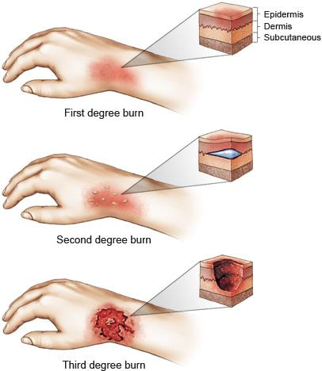
Burns can result from sources of heat, electricity, and chemicals. In situations where people are injured by these sources, your first aid knowledge should include how to prevent and treat them. This course will introduce students to the different types of burns, how to treat them, and ways to prevent them.
There are 6 basic types of burns, and they all require different treatments. Burns from heat, electricity, and chemicals will produce injuries depending on the burn’s depth, size, and location. Burns are often very painful, and can result in shock and if not treated properly, infection. This becomes even more serious depending on the victim’s age, how large a part of the body they cover, and if there are (were) other injuries involved. Finally, burns are usually classified by their heat source. Burns can come from heat, chemicals, electricity, radiation or sun.
Burns can result from sources of heat, electricity, and chemicals. In situations where people are injured by these sources, your first aid knowledge should include how to prevent and treat them. This course will introduce students to the different types of burns, how to treat them, and ways to prevent them.
There are 6 basic types of burns, and they all require different treatments. Burns from heat, electricity, and chemicals will produce injuries depending on the burn’s depth, size, and location. Burns are often very painful, and can result in shock and if not treated properly, infection. This becomes even more serious depending on the victim’s age, how large a part of the body they cover, and if there are (were) other injuries involved. Finally, burns are usually classified by their heat source. Burns can come from heat, chemicals, electricity, radiation or sun.
www.UgandaHealthNews.com

Slide 21
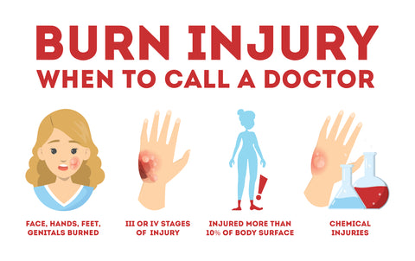
Treat heat burns based on their degree: Remember
Before treating a burn, determine its degree and treat accordingly
When deciding the degree of a burn, besides the above, it will help to know both the source of the burn and/or how hot the source was and how long the victim was exposed. If the victim appears to have a combination of burns of different degrees, determine the degree of the most worst burn – (usually in the middle of the burned area) and treat for that degree first.
If you are not sure about the burn’s degree, treat it as a third-degree burn;
The goal of burn treatment is to relieve the victim’s pain and prevent both shock, and infection.
www.UgandaHealthNews.com

Slide 22
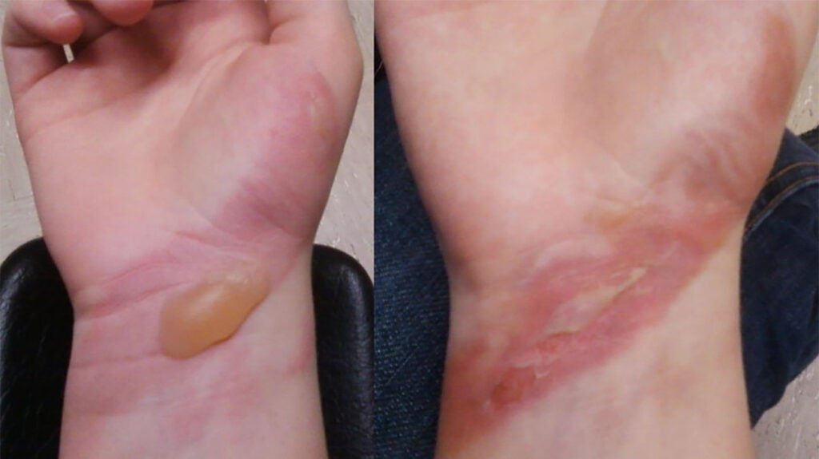
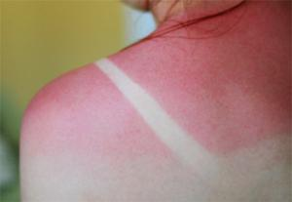
First-Degree Burns:
Least severe type of burn;
Injure only the top layer of skin;
Redden the skin;
Produce mild swelling;
Cause pain due to irritated nerve endings;
Heal quickly and completely if properly treated;
Caused by brief contact with hot objects, exposure to steam/hot water, or overexposure to wind or sunburn.
www.UgandaHealthNews.com

Slide 23
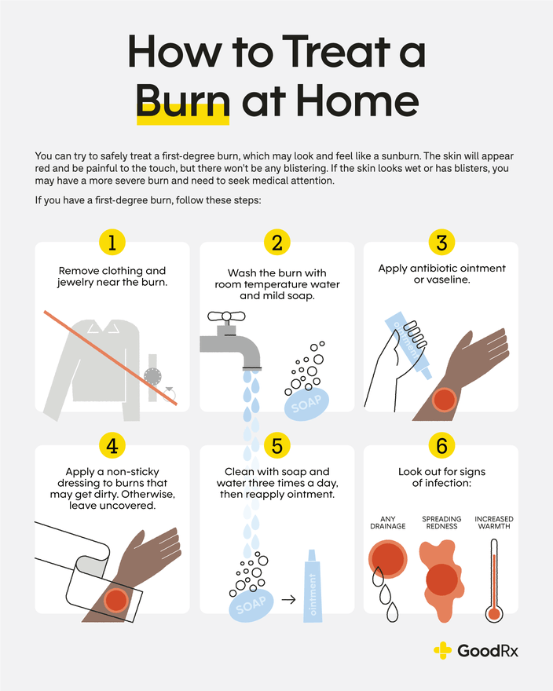
Treating First-degree Burns
Loosen tight clothing and remove jewelry from the burned area before it swells. Have the victim put his/her jewelry in a safe place after removal;
Cool the burned part with water by either holding it under cold, running water, pouring cold water over it, immersing it in cold water, or applying cold, wet compresses to it;
Cooling the burn with water helps remove heat from the skin, relieves pain and swelling, and cleans the injury. Continue this neutralizing treatment for 10 to 15 minutes or until the pain subsides;
Gently pat the burned area dry with a clean cloth;
Cover the injury with a sterile bandage or clean cloth to keep air off of it, thereby reducing pain, and protecting against infection. Keep the bandage loose to keep pressure off of the injury;
Once a first-degree burn is completely cooled, especially a sunburn, use a lotion or moisturizer to relieve pain and prevent drying of the skin.
www.UgandaHealthNews.com

Slide 24
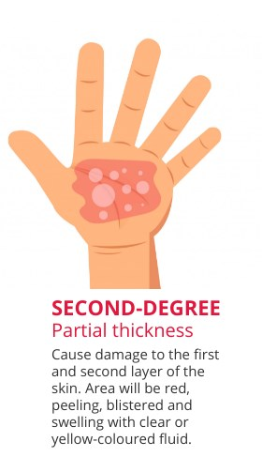
Second Degree Burns:
Second-degree burns are more serious than first-degree burns because a deeper layer of skin is burned. They can more easily become infected;
Also, if the burn affects more than 10 percent of your skin, you may go into shock because large quantities of fluid are lost from the burned area;
A medical professional should treat all second-degree burns greater than two to three inches in diameter;
Second-degree burns are usually caused by: deep sunburn, exposure to flames, contact with hot liquids, burning gasoline or kerosene, or contact with chemicals and they:
  Involve deeper layers of skin;
  Cause skin to turn red and/or mottled and can produce blisters and swelling;
  Appear moist and oozing from the loss of fluid through damaged skin layers;
  Are usually the most painful burn type because nerve endings are still intact even though tissue damage is severe.
Slide 1
www.UgandaHealthNews.com

Slide 25
Second Degree Burns:
Slide 2
Burns covering a large area may cause shock due to extensive loss of fluid from the burned skin;
Properly treated, smaller second-degree burns should heal within 2 weeks with little or no scarring;
Use the following steps for treating Second-Degree Burns (Slide show will have a picture)
    If you use running water to cool the injured part, ensure the water is not so forceful that blisters on the burned skin are broken;
    Elevate the burned part;
    Ensure the victim drinks plenty of liquids to avoid dehydration;
    Seek medical treatment for second-degree burns to the face, hands, feet, or genitals, or that are more than two to three inches in diameter
www.UgandaHealthNews.com

Slide 26
Treating Second Degree Burns
For Second-Degree Burns (Affecting Top 2 Layers of Skin)
Cool Burn. Immerse in cool water for 10 or 15 minutes.
Protect Burn. Cover loosely with sterile, nonstick bandage and secure in place with gauze or tape.
Prevent Shock. Unless the person has a head, neck, or leg injury, or it would cause discomfort:
See a Doctor.
www.UgandaHealthNews.com

Slide 27
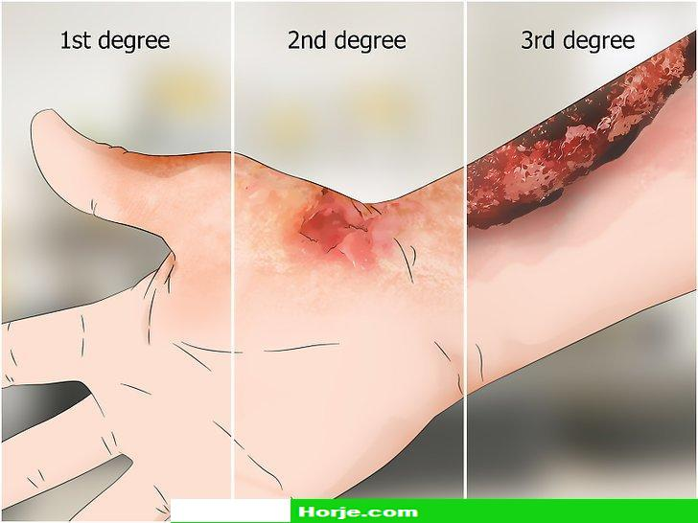
Third Degree Burns:
Slide 1
Third-degree burns are the most serious because they involve all skin layers. These types of burns are so deep that only the edges will heal and scars will eventually cover the rest of the burned area. Skin grafts and plastic surgery may be needed, so a medical opinion is often needed.
Third-degree burns are usually caused by: clothing on fire, immersion in hot water, contact with flames, hot objects, electricity, or corrosive chemicals. They have the following characteristics:
Deepest and most severe type of burn;
May look white or charred (may appear to be a second-degree burn at first);
www.UgandaHealthNews.com

Slide 28
Third Degree Burns:
Slide 2
Result in deep tissue destruction, reaching all layers of the skin and sometimes structures below the skin
Often cause little or no pain since nerve endings are destroyed
Often cause shock
When healed, will be covered by scar tissue
Caused by immersion in extremely hot water, prolonged contact with flames, and electric shock.
www.UgandaHealthNews.com

Slide 29
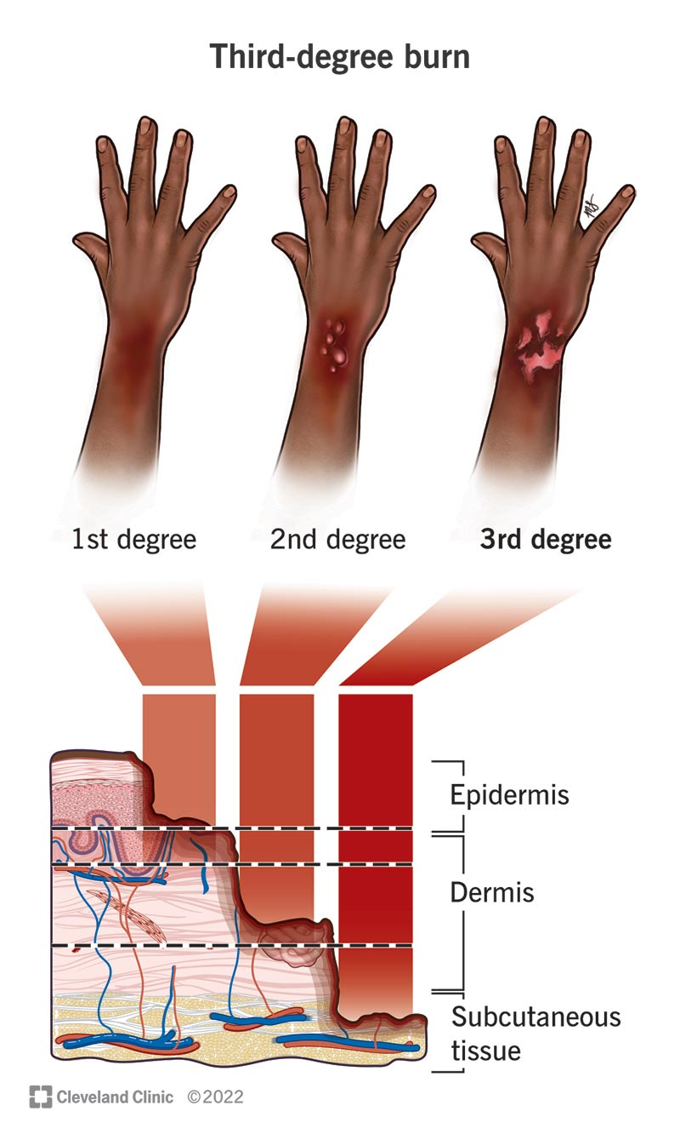
Treating Third-Degree Burns
Slide 1
These are the deepest and most severe type of burn. To treat these burns, do the following:
Remove the victim from the source of heat if he/she is still in contact with it;
Next, call for Emergency Medical Services (EMS). All third-degree burns require medical treatment regardless of their size. Until the victim receives treatment, follow steps three through nine;
Ensure that the victim is breathing. If not, begin mouth-to-mouth resuscitation. See Lesson 2 for mouth-to-mouth resuscitation procedures. If the victim is breathing, continue with steps four through nine;
Remove any clothing that is still smoldering to stop further burning. If the victim is wearing jewelry that is near or on a burned area, remove it if it comes off easily. Place the jewelry in the victim’s pocket, purse, etc., if available. If not, reassure the victim that you will give his/her jewelry to emergency medical personnel when they arrive;
www.UgandaHealthNews.com

Slide 30
Treating Third-Degree Burns
Slide 2
If necessary, expose the burned area by cutting and gently lifting away any clothing. If any cloth sticks to the burn, leave it in place. Note: If you are in a chemically contaminated area, do not expose the burned area; simply apply a dressing over the victim’s clothing;
Cover the burned area loosely with cool, moist compresses, sterile bandages, or clean cloth. Note: Unlike treatment for first- and second-degree burns, do not cool a third-degree burn with water, since this can increase the risk of shock;
Elevate the burned part;
Treat the victim for shock. See Lesson 4 for procedures for treating shock. Pay special attention to the victim’s body temperature, which can change rapidly due to the skin being burned;
Monitor breathing of victims with burns to the face and burns resulting from fire accompanied by smoke inhalation. Treat accordingly.
www.UgandaHealthNews.com

Slide 31
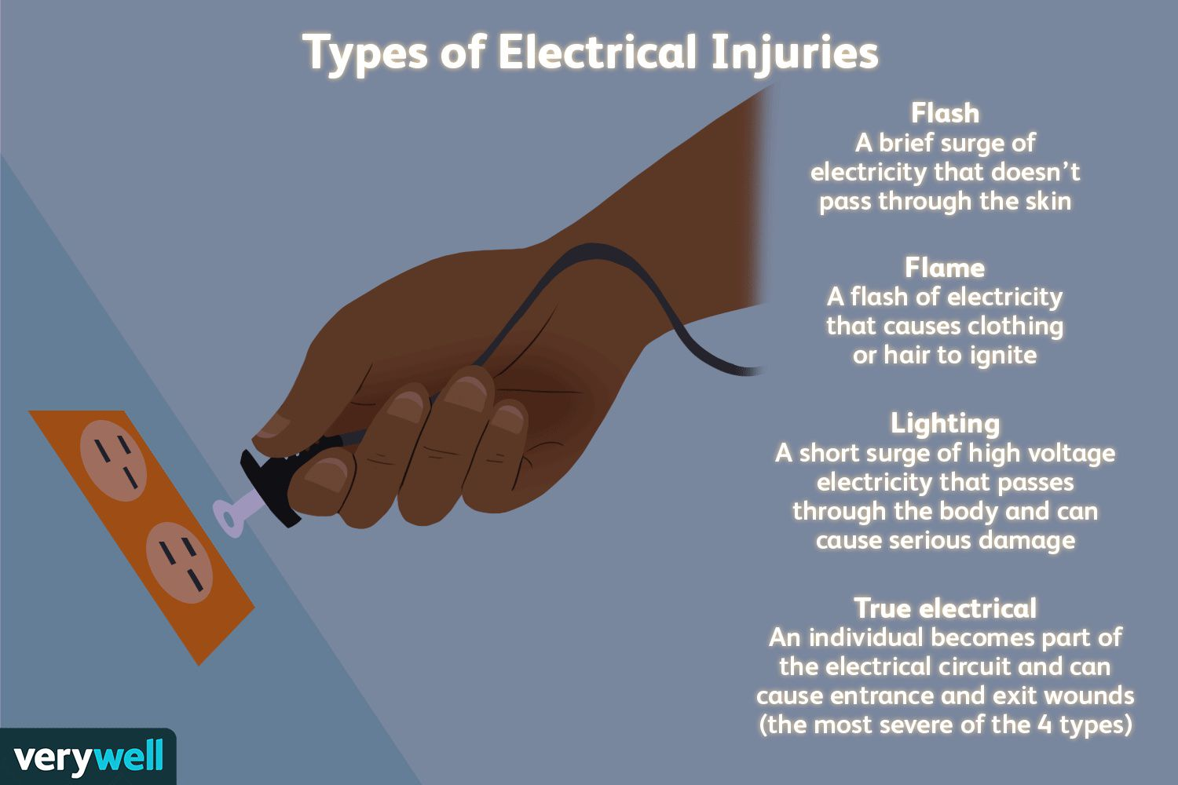
ELECTRICAL BURNS:
Electrical shocks often produce a minor skin mark. Even so, the injury can be a serious if not treated properly. Therefore, all deep-tissue electrical burns should be treated as third degree burns. The current from an electrical shock passing through a victim’s body can also result in unconsciousness and may slow or stop his or her breathing and/or heartbeat, meaning that you should treat an electrical shock as a potentially life-threatening injury. If you believe a person has been electrocuted, assess the situation first before touching the victim. He or she may still be in contact with the electrical current, and if you touch him or her, you could become a victim of electrical shock as well.
www.UgandaHealthNews.com

Slide 32
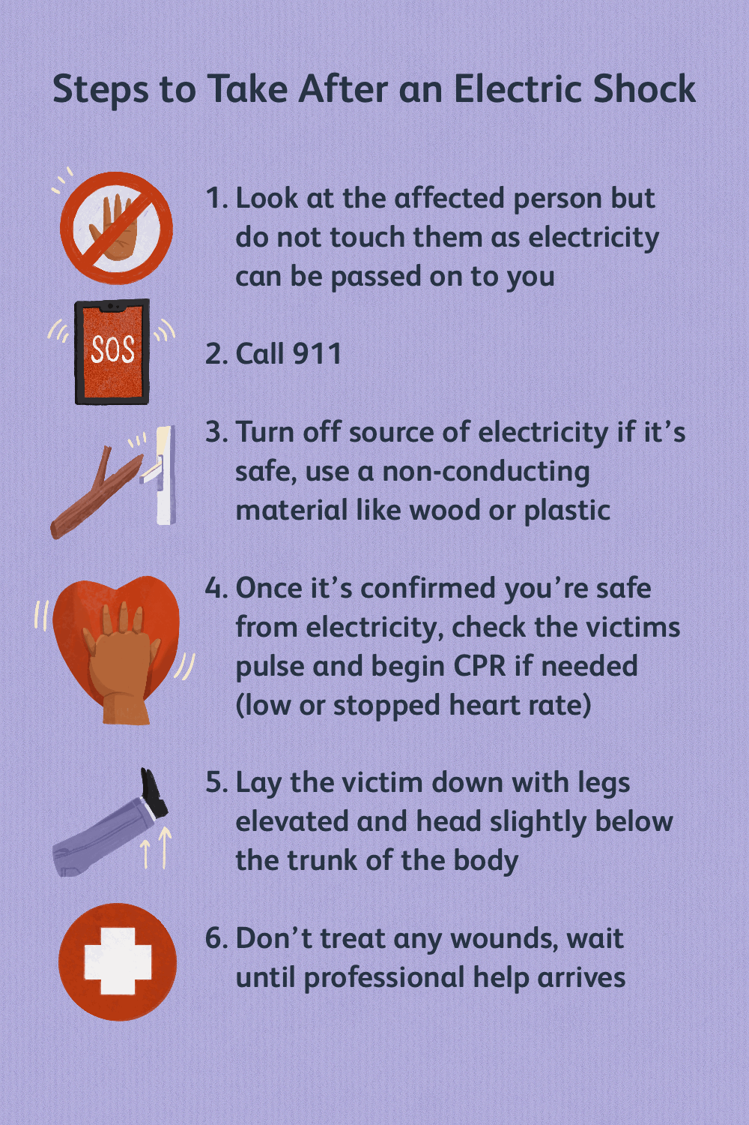
Treating Electrical Burns
Slide 1
If the victim is still in contact with the source of electricity, stop the current.
  Shut off the electrical current by unplugging a cord, removing a fuse from the fuse box, or turning off the circuit breaker, as appropriate. Note: In many cases, just turning off a wall or appliance switch does not stop the electrical flow. Even though you have shut off the electrical current, to be completely safe, move the victim away from the electrical source before continuing. Proceed to step three;
  If you cannot turn off the electricity or you are outside and the shock is due to a downed power line, either call the power company yourself if you have a phone near you, or if there are other people around, have someone else call the power company. Meanwhile, since it may take you less time to separate the victim from the current than to wait for the power to be cut off, proceed to step two. Or, if you are alone and/or there is no phone readily available in this situation, proceed to step two.
Separate the victim from the source of electrical current;
www.UgandaHealthNews.com

Slide 33
Treating Electrical Burns
Slide 2
Push the victim off of or away from the source of electricity — or push the source of electricity off of or away from the victim — using a dry non-conducting material (wood, plastic, cardboard) like a broom, stick, or chair. If available, also stand on something dry and non-conducting, like newspaper or a rubber mat, as you disengage the victim. If pushing does not work, use a dry rope or dry clothing to lift or drag the victim off of or away from the source of electricity. This method works better if there are two rescuers: one to lift the victim off and the other to push the electrical source away;
Check the victim’s breathing and pulse. Be prepared to administer mouth-to-mouth resuscitation or cardiopulmonary resuscitation (CPR) if the victim’s breathing is shallow or nonexistent or his/her pulse is dangerously slow or nonexistent;
Once you are sure the victim is breathing, take the time to call EMS if you or someone else has not already done so. 5. Check the victim for two burn sites — one where the electricity entered the body and one where it exited the body. Treat the burns by following steps four through nine for treating third-degree burns, including treating for shock and monitoring breathing.
www.UgandaHealthNews.com

Slide 34
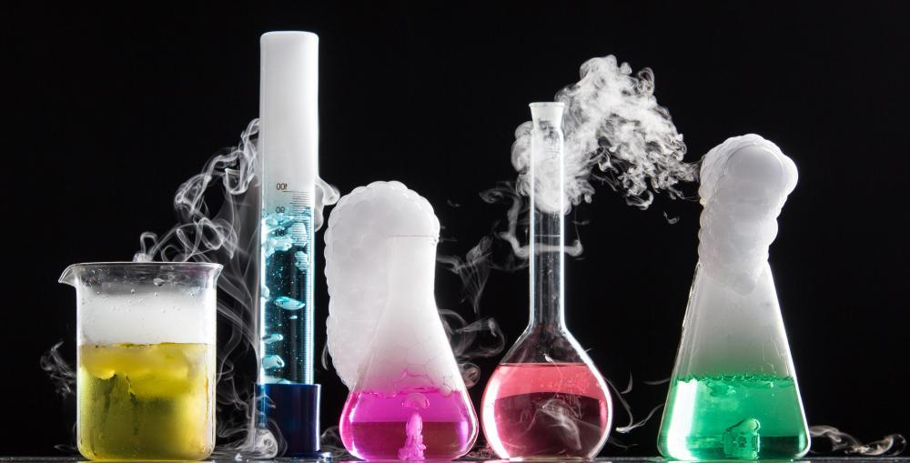
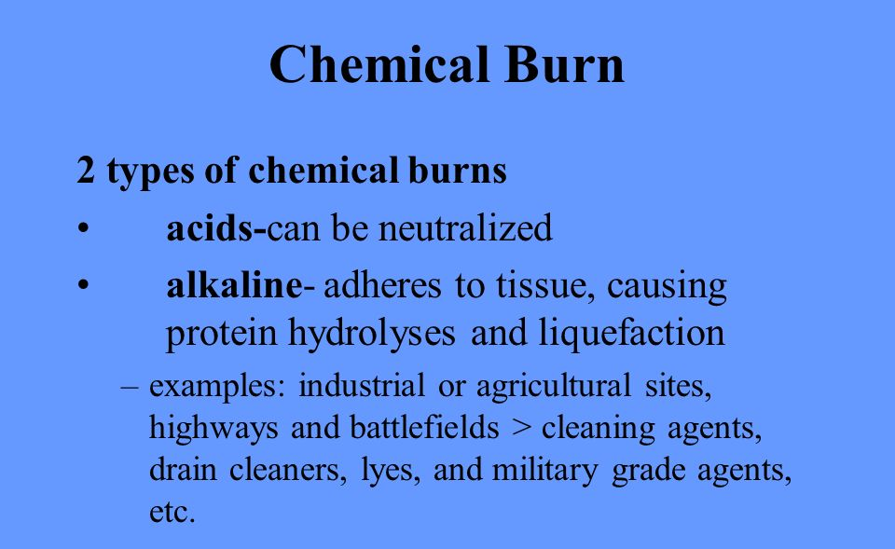
Chemical Burns
Chemical burns occur when the skin or eyes come in contact with liquid or dry chemicals that are caustic or irritating. Around your house, you may have products like rust and paint removers and drain and cement cleaners that contain acids designed to eat away certain materials and bases (also called alkalis) used to cut through grease. If used carelessly or improperly, these products may also do the same to your clothes and skin.
www.UgandaHealthNews.com

Slide 35
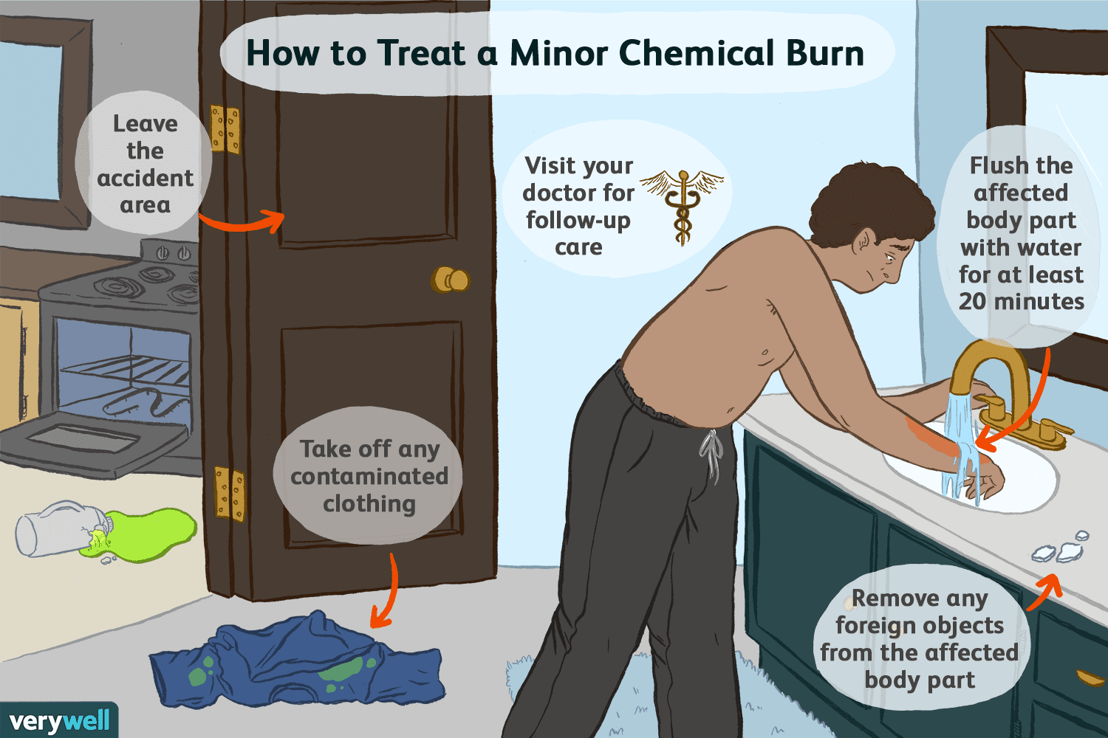
Treating Chemical Burns
Treatment of chemical burns involves stopping the chemical action immediately by removing the chemical from the skin or eyes and by removing contaminated clothing that can transmit absorbed chemicals to the skin. Treatment will vary depending on the type of chemical involved, so if there are first aid instructions on the label of the chemical product causing the burn, follow those instructions. If not, use the following basic guidelines for treatment.
www.UgandaHealthNews.com

Slide 36
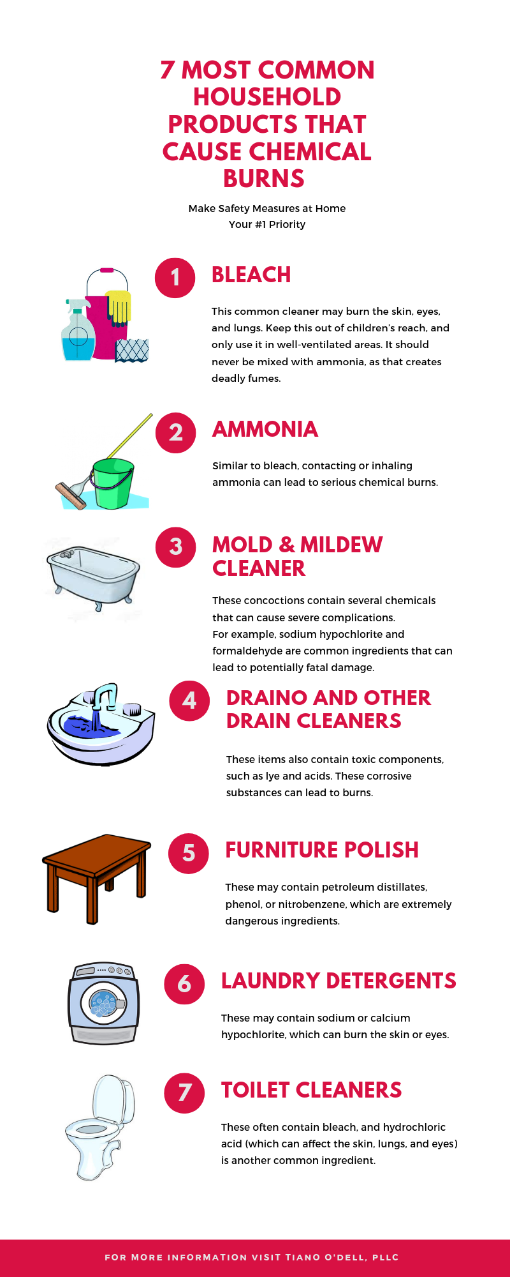
Treatment for
Chemical Burns to the Skin
Depending on the extent of chemical coverage on the victim or in the area, consider wearing gloves and/or safety goggles, if available, to protect yourself from chemical injuries while assisting the victim;
Remove the victim’s contaminated jewelry and clothing, including shoes and socks where chemicals can collect;
Remove the chemical from the skin;
  For liquid chemicals, flush them from the contaminated skin with large amounts of cool running water for at least 15 minutes.
  For dry chemicals, brush them off the skin using a clean, dry cloth. Take care to keep the chemicals from blowing into your eyes or the victim’s eyes, and avoid brushing the chemicals onto your own skin. Then, if large amounts of water are available, flush the contaminated area for at least 15 minutes. If large amounts of water are not available, do not apply any water to the contaminated area, since small amounts of water can react with dry chemicals causing more burning.
Cover the burned area loosely with dry, clean bandages or clot
Minor chemical burns generally heal without further treatment; however, call for Emergency Services for:
  any chemical burn to the face, hands, feet, genitalia, or joints
  second-degree chemical burns over two to three inches in diameter
  all third-degree chemical burns
  if there is a systemic reaction to the chemical burn and/or chemical exposure
www.UgandaHealthNews.com

Slide 37
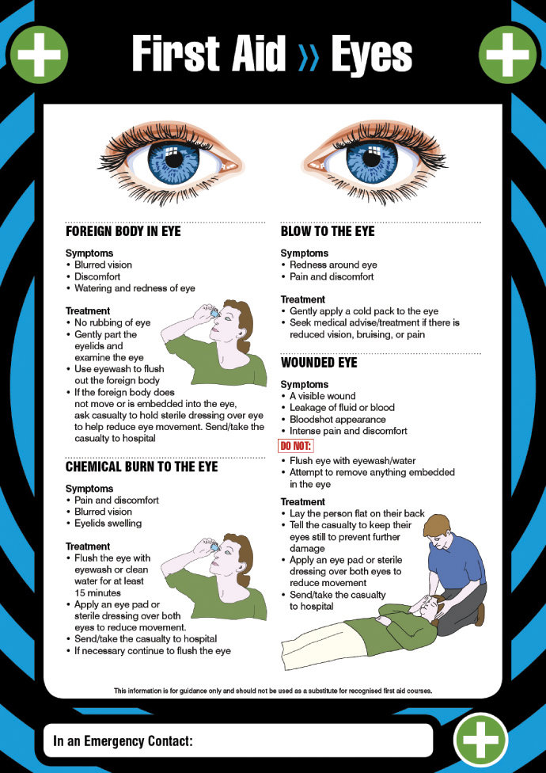
Treatment for Chemical
Burns to the Eyes
Position the victim’s head so that the injured eye is lower than the uninjured eye. This will prevent the chemical from getting into the uninjured eye. If both eyes are injured, proceed to Step two;
If there is only one injured eye, hold the eyelids of the injured eye open and flush with water from the inner corner of the eye (closest to the nose) to the outer corner (closest to the ear). Flush for at least fifteen minutes. If both eyes are injured, flush both at the same time;
To keep the victim from moving his/her injured eye(s), have the victim close both eyes, then cover them with cloth pads or gauze taped loosely into place. Since eyes move together, both eyes must be closed and covered to keep the injured eye still;
Call for Emergency Medical Services or transport the victim to the emergency room.
www.UgandaHealthNews.com

Slide 38
Note: as we develop this program, there will be a special section created for educators. There, we will be updating and adding material to our website.
www.UgandaHealthNews.com
www.UgandaHealthNews.com

Slide 39
www.UgandaHealthNews.com
www.UgandaHealthNews.com

